Slide 1
0x409 – Ghidra Setup for Embedded R.E.
ECED4406 – Computer Security
Dr. Colin O’Flynn
Dalhousie University.

Slide 2
Importing a Binary to Ghidra
Four important setup details we typically need:
Find the processor module to load (“language”).
Find the address offset of the binary.
Setup address space in Ghidra.
OPTIONAL: Setup peripheral file (SVD).
Understand the interrupt vectors.

Slide 3
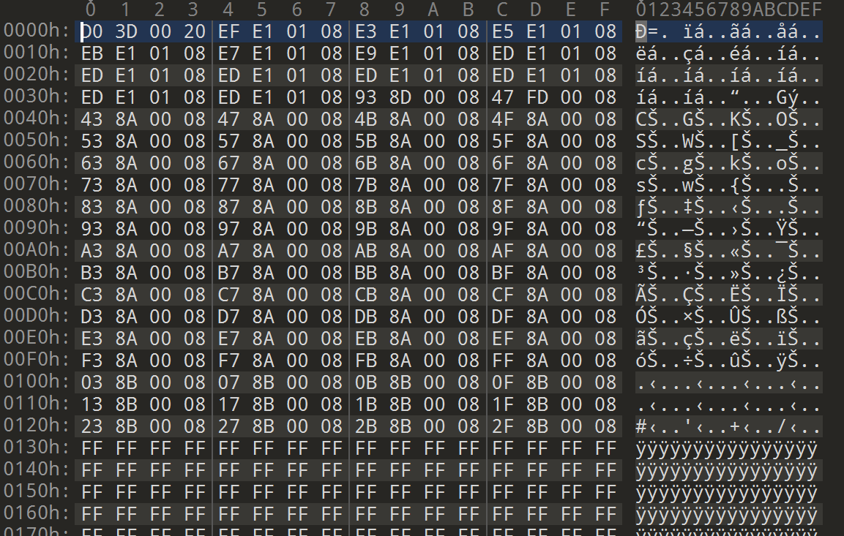
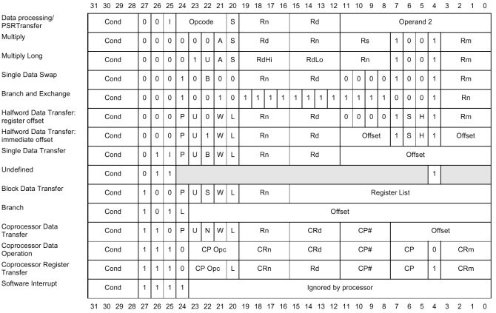
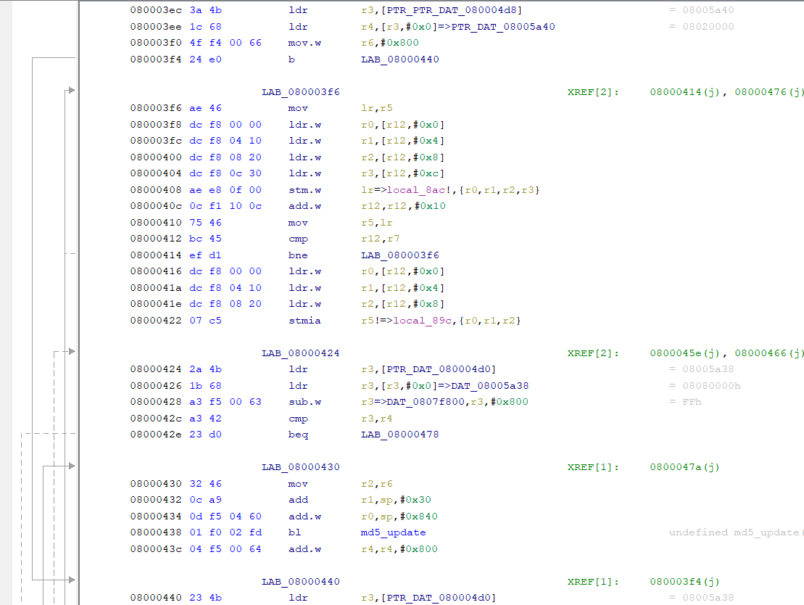
STEP 1: Processor Module
Binary Data
Decoded into Machine Code
Assembly Language Output

Slide 4
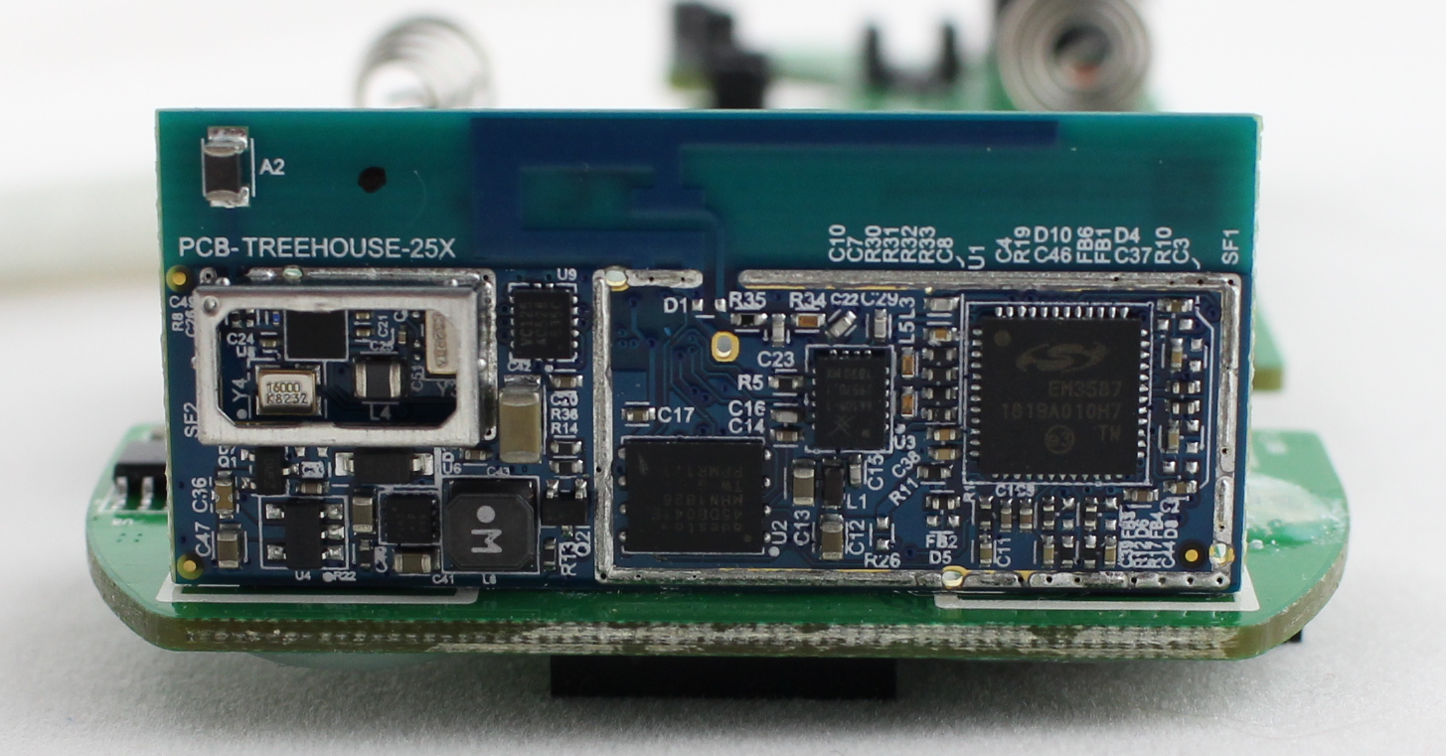
Example #1: Smart Lock
EM3587

Slide 5
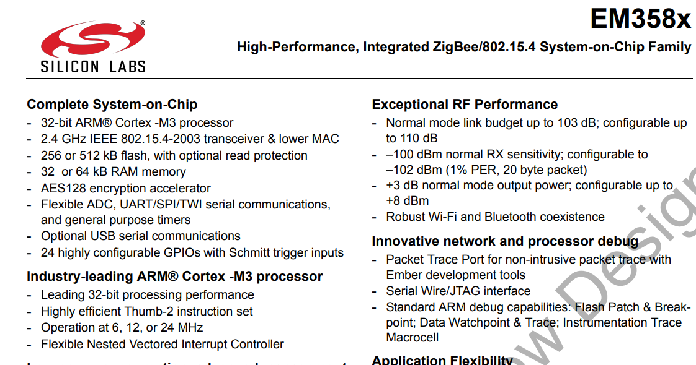
Arm Cortex-M
Find datasheet for main processor → EM3587 → Arm Cortex-M

Slide 6
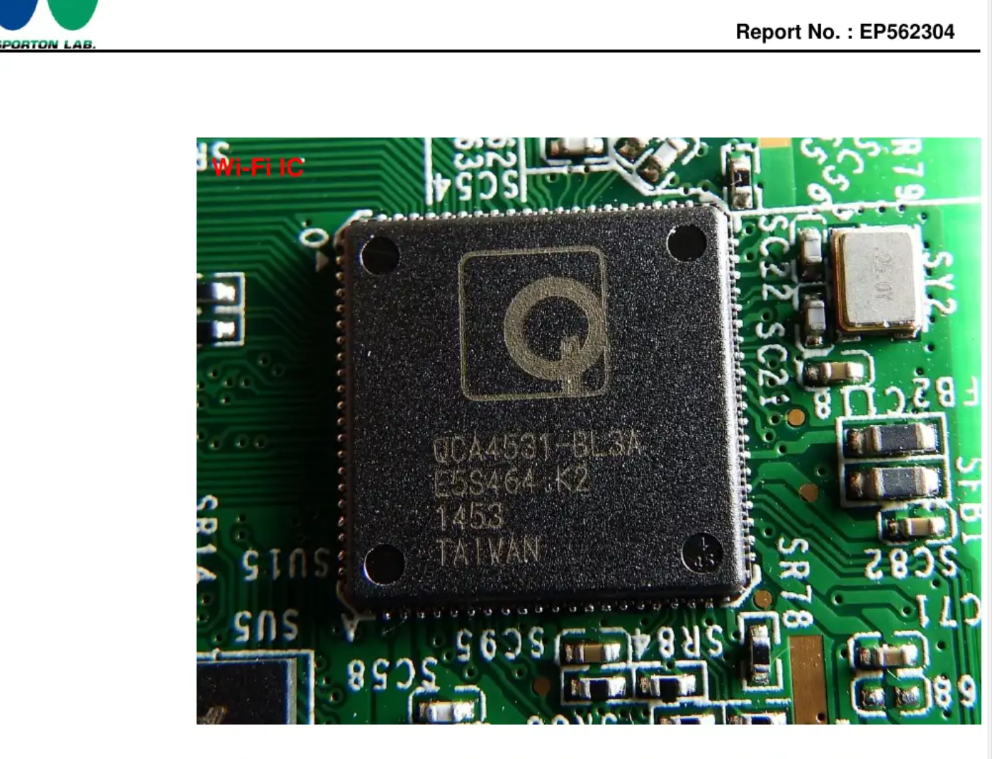
Example #2: Phillips Hue 2.0 Bridge
From FCC filing – no screwdriver needed!
QCA4531

Slide 7

MIPS 24Kc
MIPS 24Kc

Slide 8
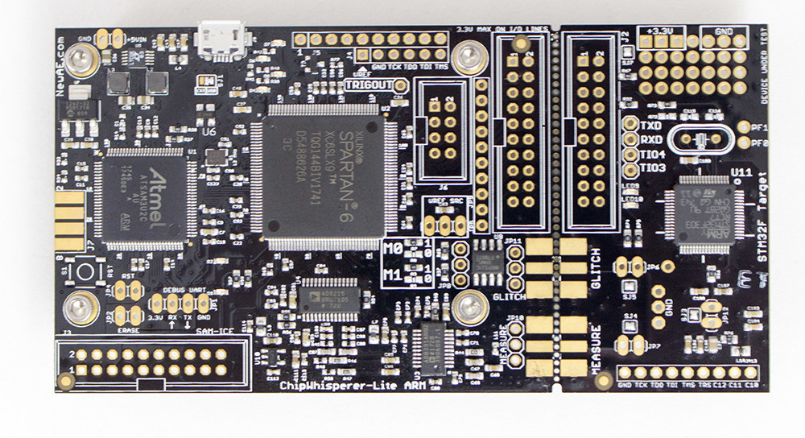
Example #3
STM32F303RCT7

Slide 9
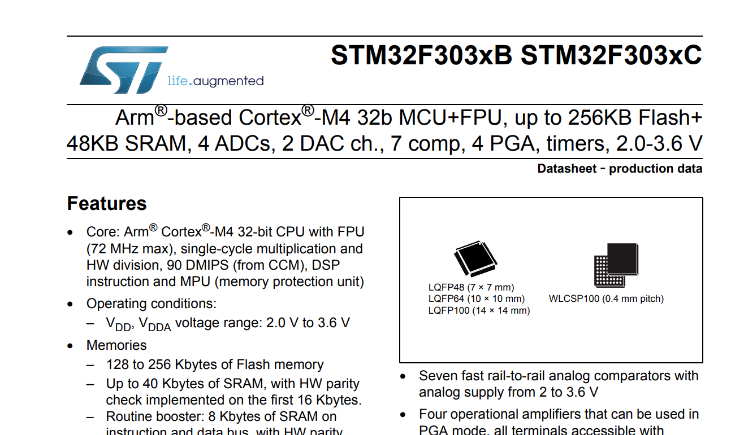
Arm Cortex-M

Slide 10
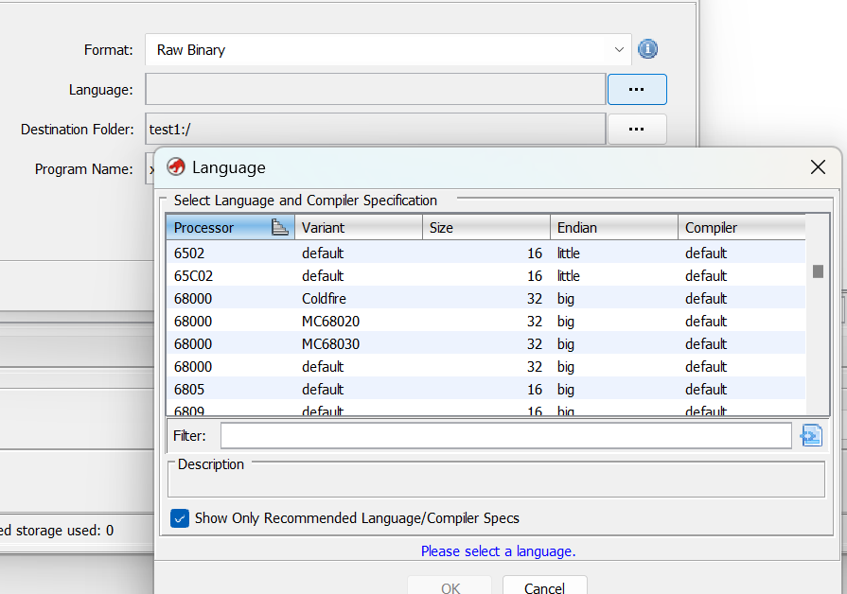
Result of Step 1
Some devices (such as Arm Cortex-M) have an easy choice here.
Some devices may have lots of variants – may need to investigate what the most likely requirement is.
Sometimes have to try a few and see if some make “more sense”.
But first…

Slide 11
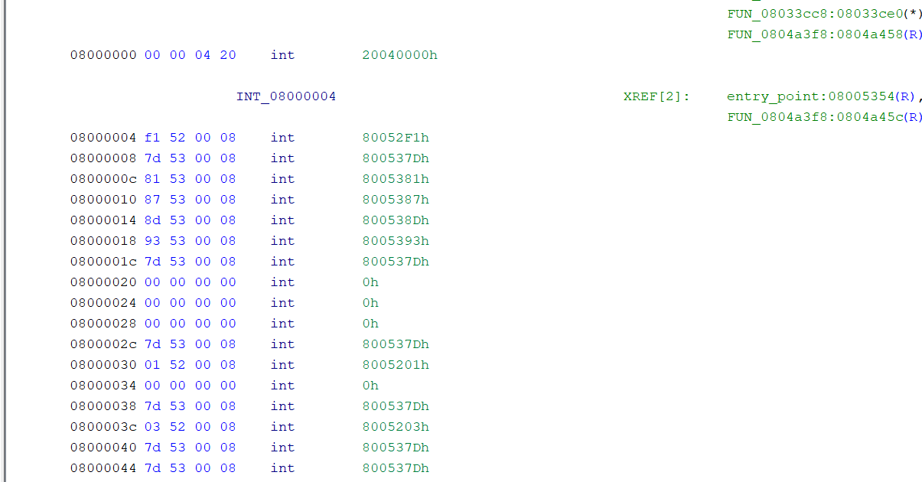
STEP 2: Base Address
Why is file loaded at 0x8000000?

Slide 12
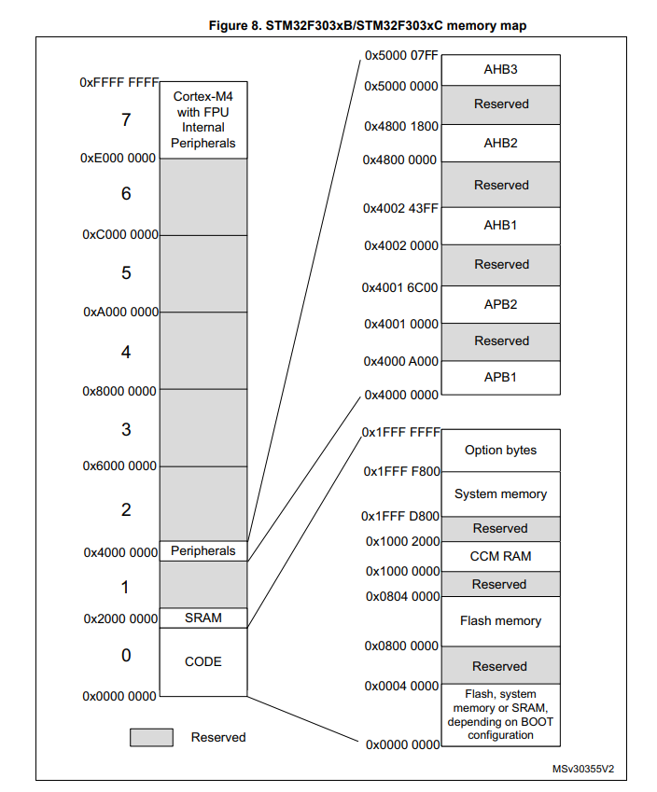
Base Address: Processor / Architecture
Note – FLASH Memory starting at 0x8000000

Slide 13
Offset Due to Bootloader
0x80080000
0x78000
Application Flash
Update Firmware File
0x80008000
0x80007FFF
Bootloader 32 KB
0x00000
0x80000000

Slide 14
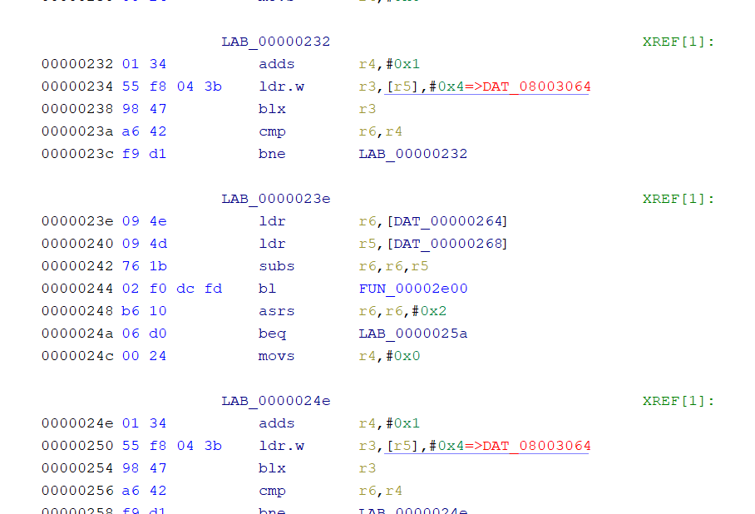
What If Offset is Unknown?
You can often load with a default base address (0), and then look at the results to see where loads are coming from:
Base Address (0)
Load from memory space 0x8000000
NOTE: many references are relative which means they “shift” with your specified base address.

Slide 15
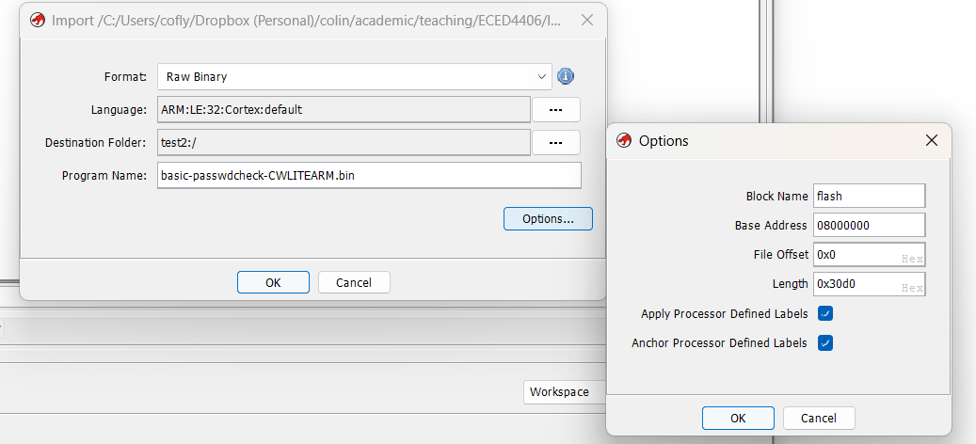
Result of Step 2
Remember – needed because this is binary, but in some cases update files may still have an offset due to the bootloader.
Set my base address here, and optionally specify a name for it.
This “offset” is just used to skip parts of the file. Not the same as base address!

Slide 16
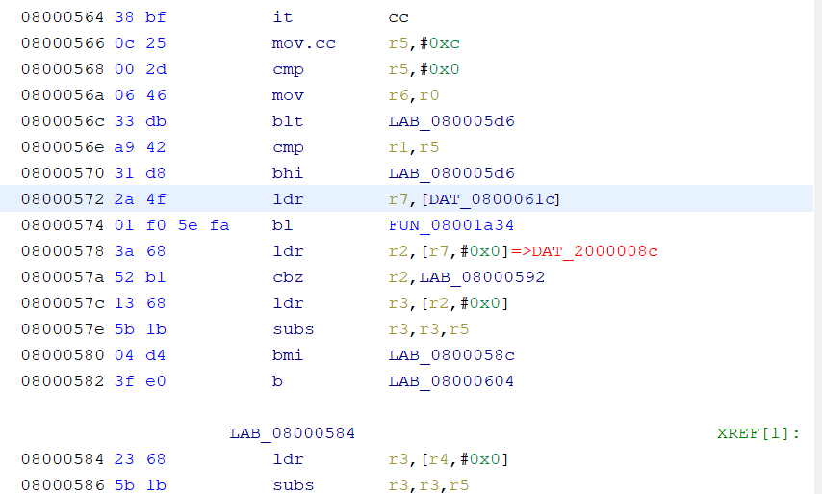
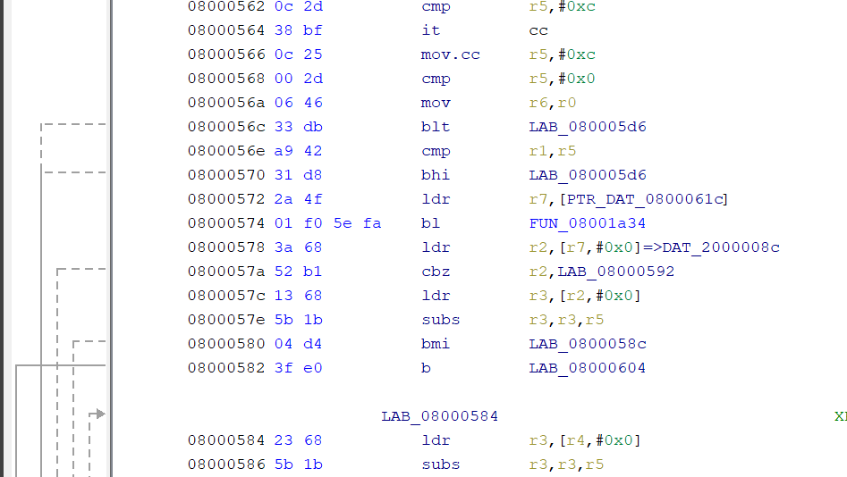
Step 3: Address Space Setup
Basic: Not Setup
Basic: Setup

Slide 17
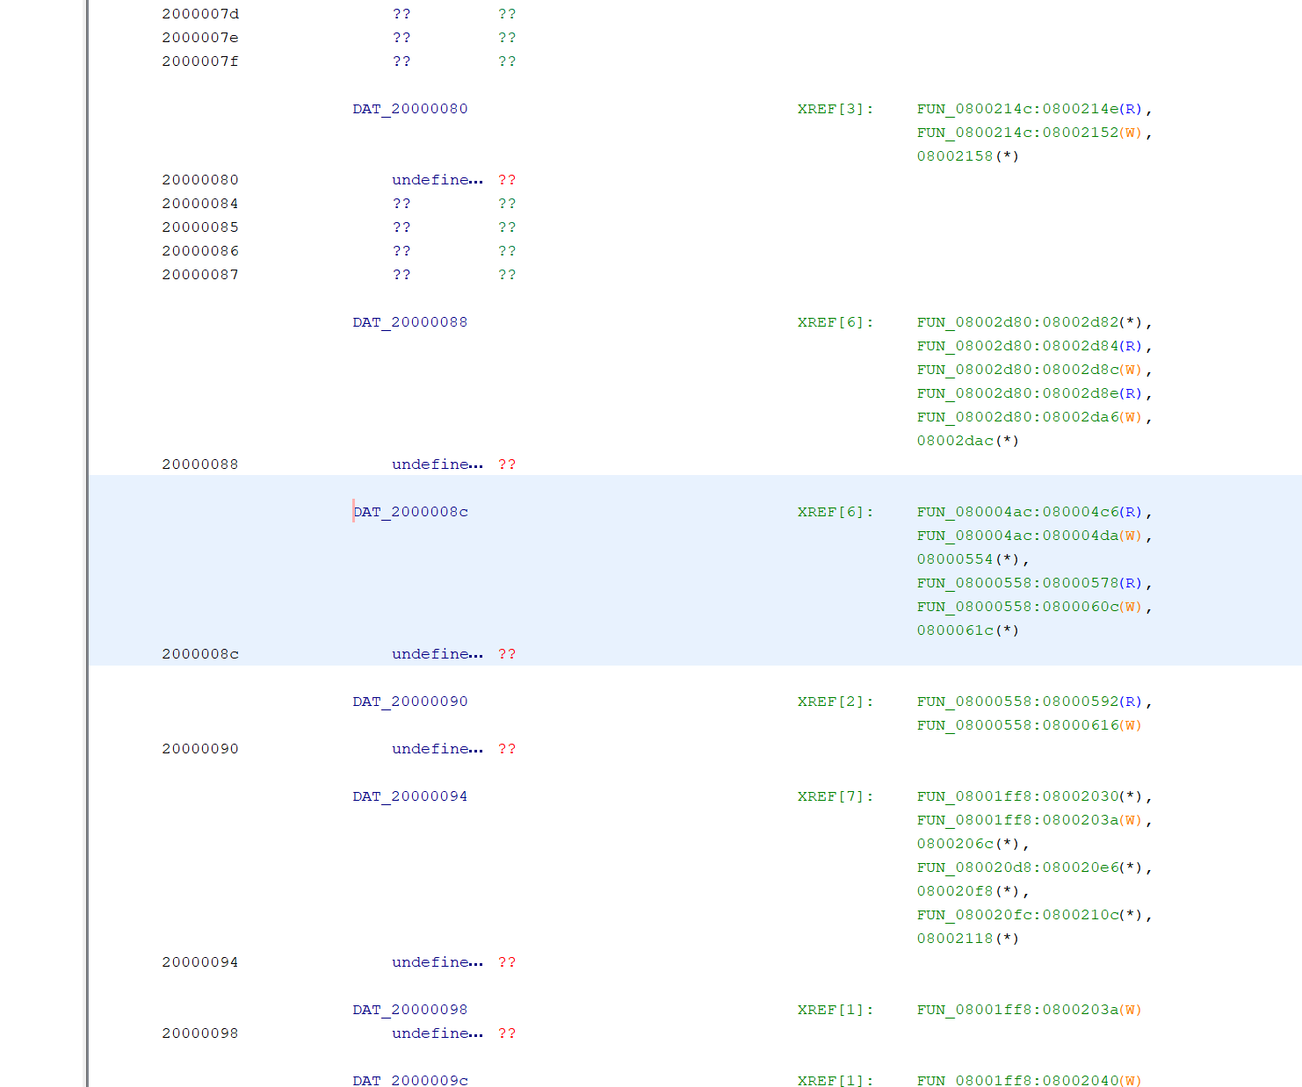
Main Advantage: Working XREFs
These are locations in SRAM referenced by the code – maybe globals for example, so once we determine what is stored in a global we can more easily track it’s usage.

Slide 18
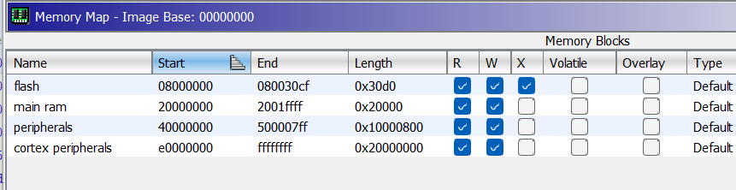

Slide 19
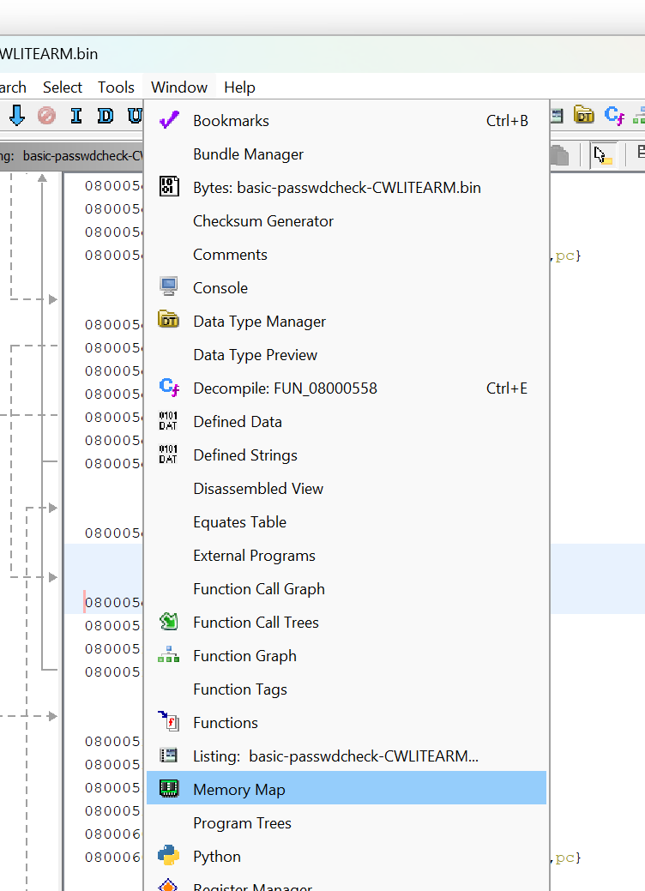
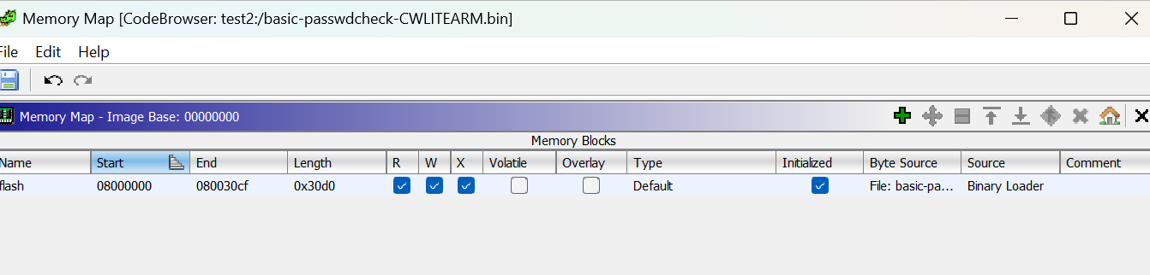
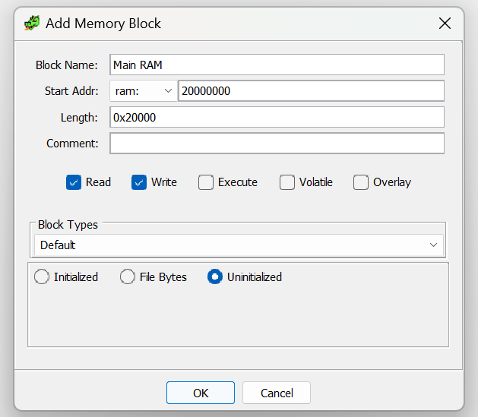
Accessing Memory Map Window

Slide 20
After Address Space Setup
After doing address space setup → Run auto analysis again.

Slide 21
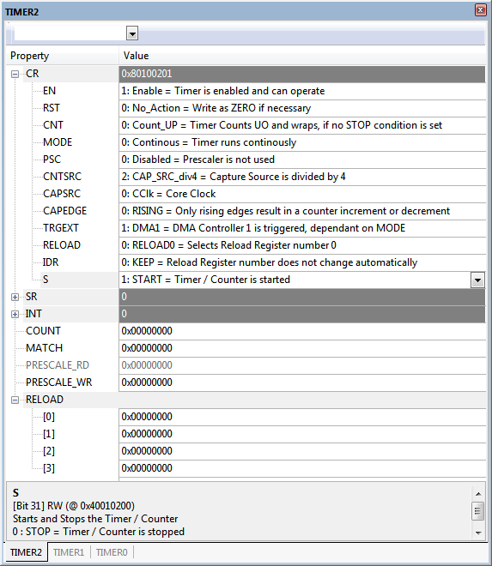
Using Peripheral Debug Files
Many vendors provide files to help with debugging devices.
These formats will vary with vendor, but for Arm they are known as System View Description (SVD) files.

Slide 22
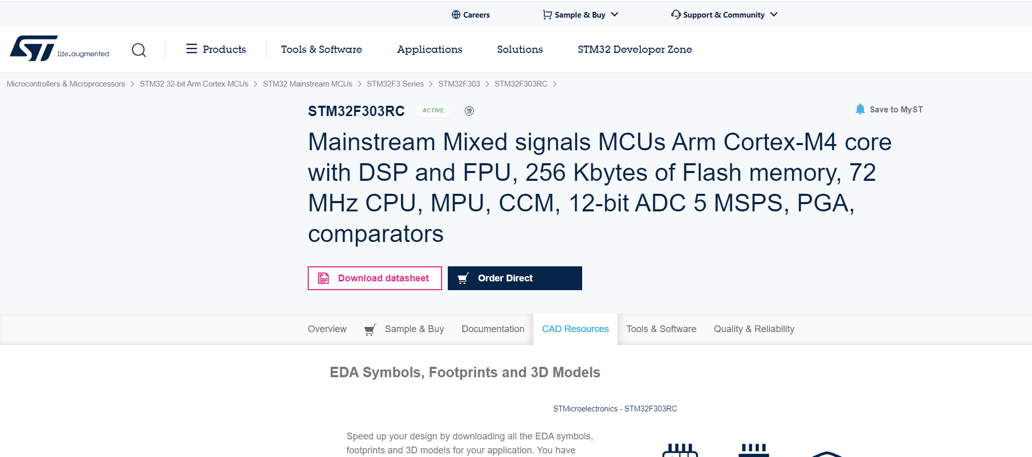
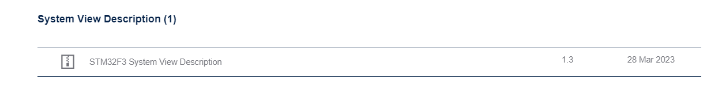
Finding SVD Files
Check vendor website:
E.g https://www.st.com/en/microcontrollers-microprocessors/stm32f303rc.html#cad-resources
Check github:
Good large repo at https://github.com/cmsis-svd/cmsis-svd/tree/main/data
Search other repos where they may be checked in…

Slide 23
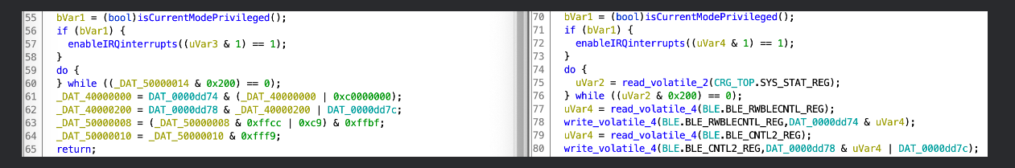
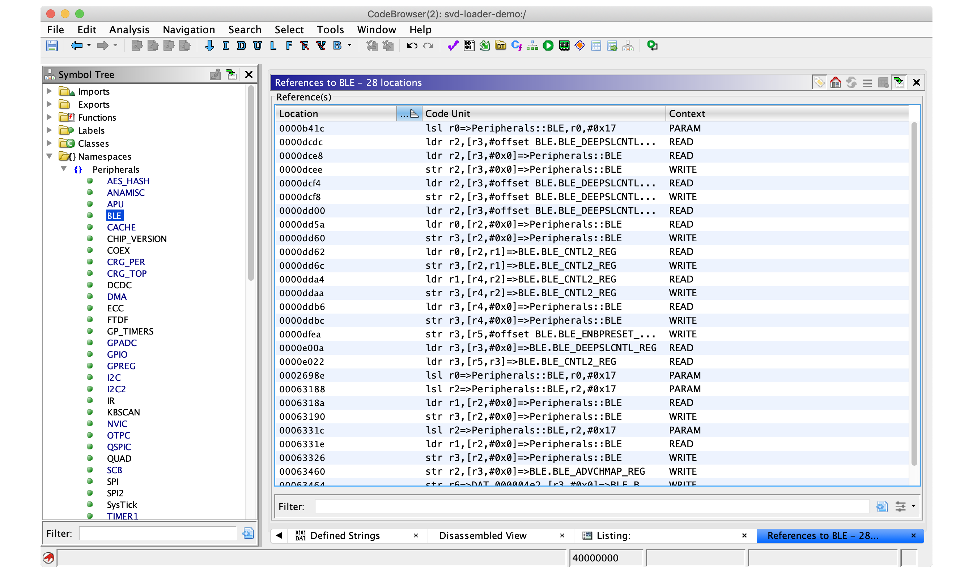
Leveldown SVD Loader
https://leveldown.de/blog/svd-loader/

Slide 24
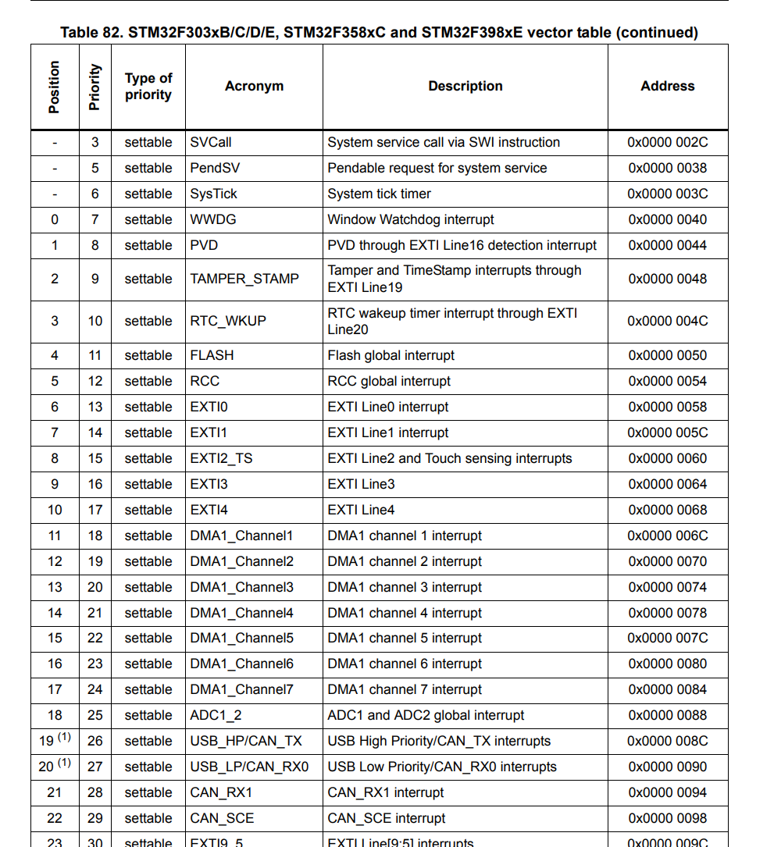
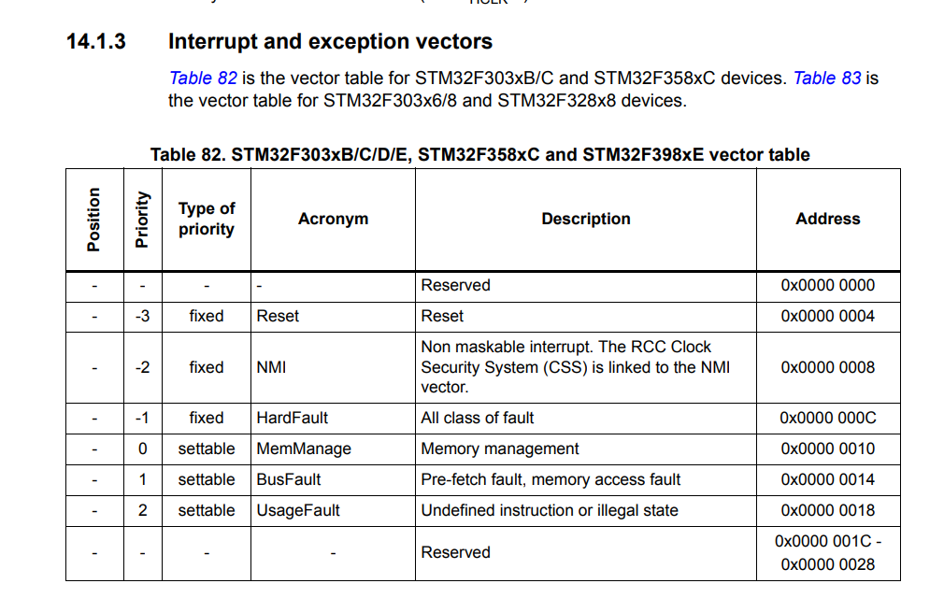
Step 4: Interrupt Vectors

Slide 25
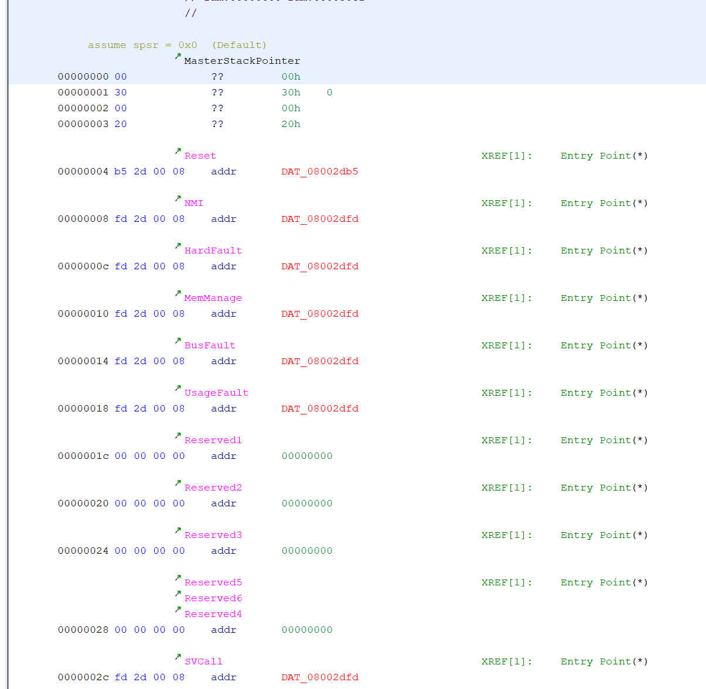
Understanding Interrupt Vectors in Ghidra
For some processors (e.g., Cortex) some of the base vectors are known and will be nicely annotated as here.
Sometimes they are not well specified and you’ll need to label them.

Slide 26
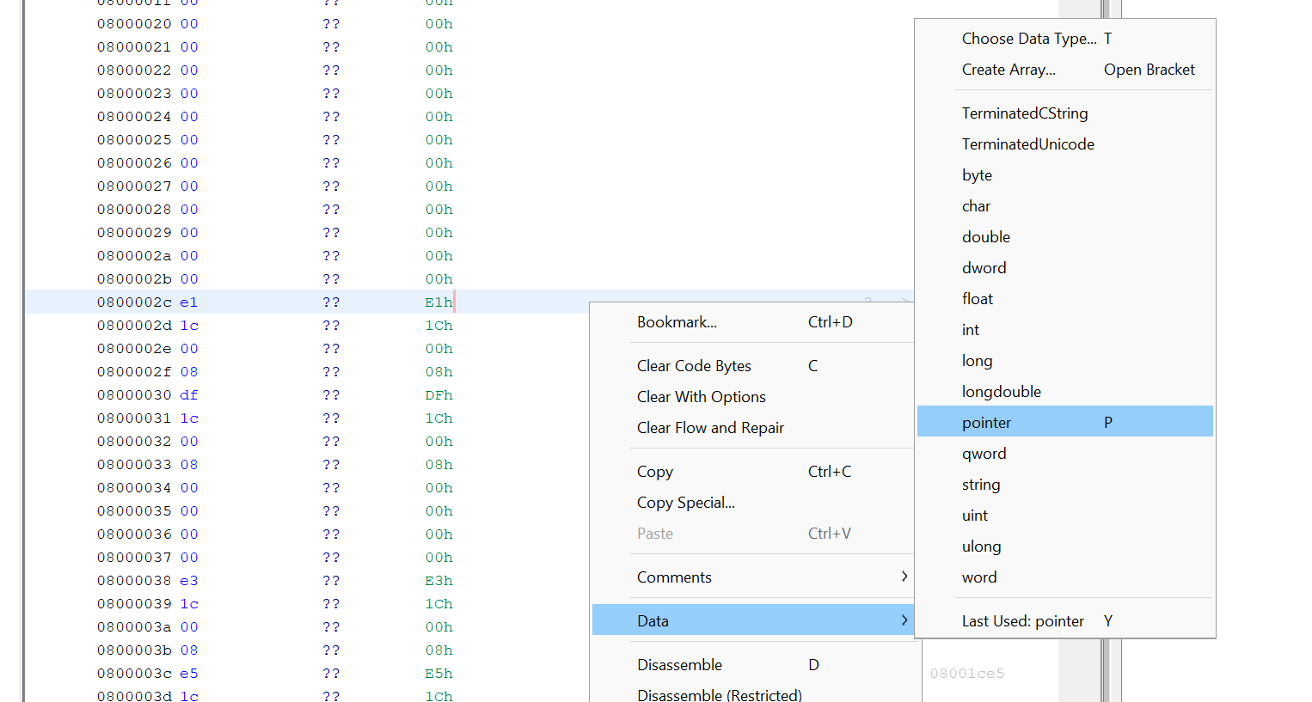
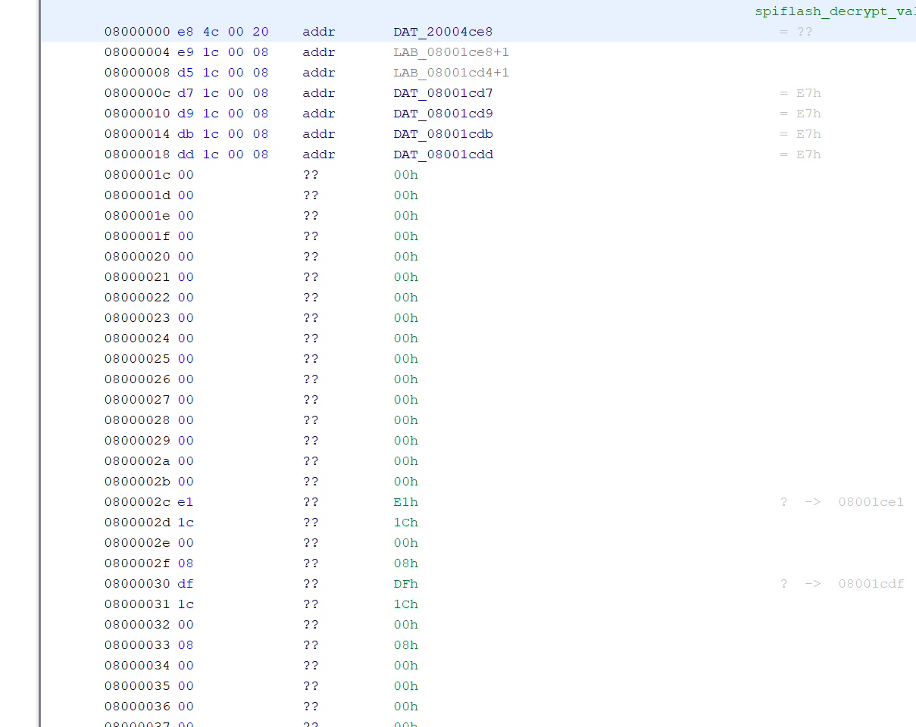
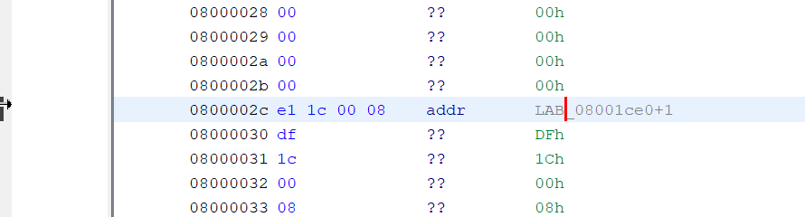
Changing Data Types
Double-click to jump to code
Right Click

Slide 27
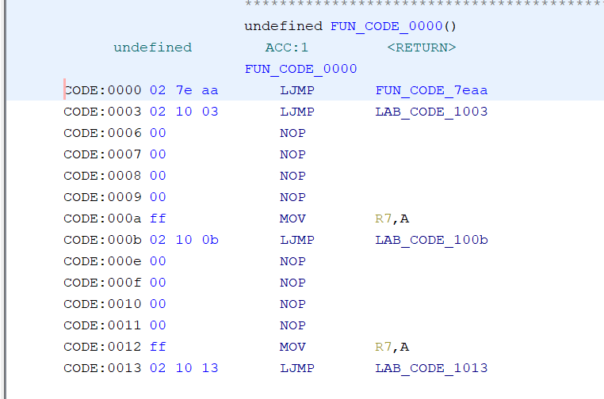
Interrupt Vectors in Other Processors
On many devices there is no vector table, but instead the vectors have limited code-space. Normally “jump” instructions are encoded here.

Slide 28
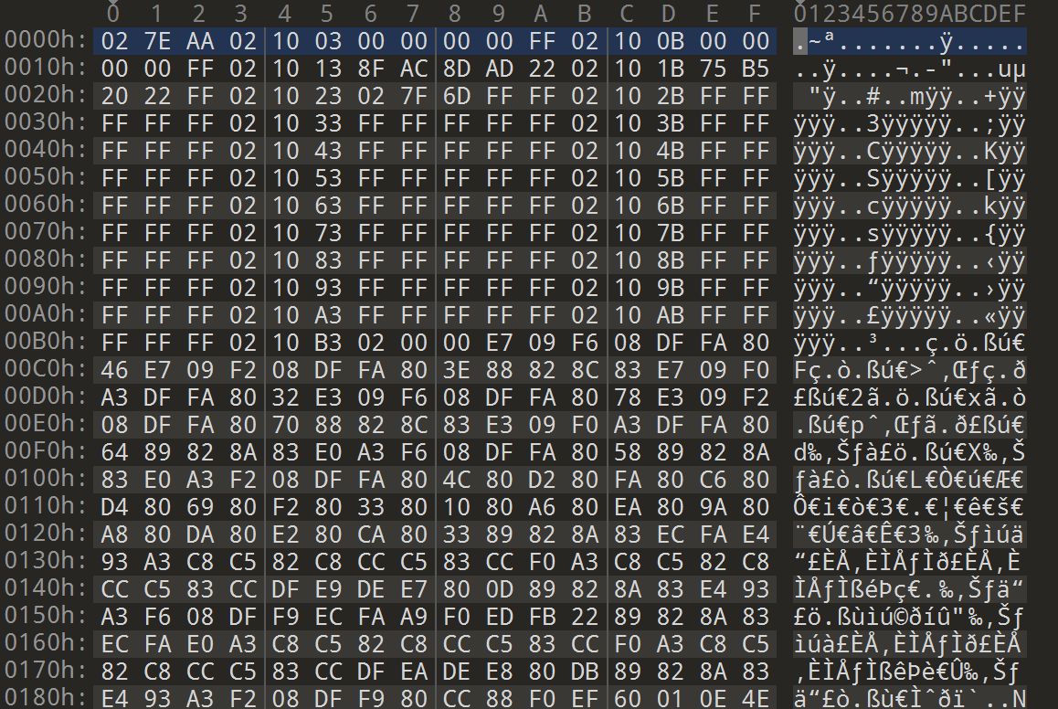
TIP #1: Using interrupt vectors to identify binaries
Vectors normally have very specific structure.
Often many are unused which will jump to the same default interrupt handler.
This applies across most architectures, not just Cortex-M – this example is an 8051 interrupt vector.

Slide 29
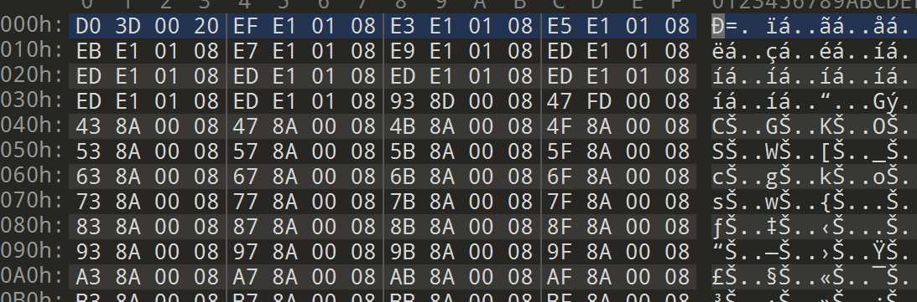
TIP #2: Use Interrupt Vectors to Identify Base Address
Stack is at 0x20003DD0:
-> SRAM must be in that location. We would guess 0x20000000 maybe?
ISRs range from 0x80008A43-0x8011EEB
-> FLASH must be in that location. We might guess starts around 0x80000000?

Slide 30
Final Step: Running Auto-Analysis
If doing this setup, suggest to NOT run auto-analysis when first loaded.
Do all your memory space / SVD setup, then run auto-analysis:

